Slide 1
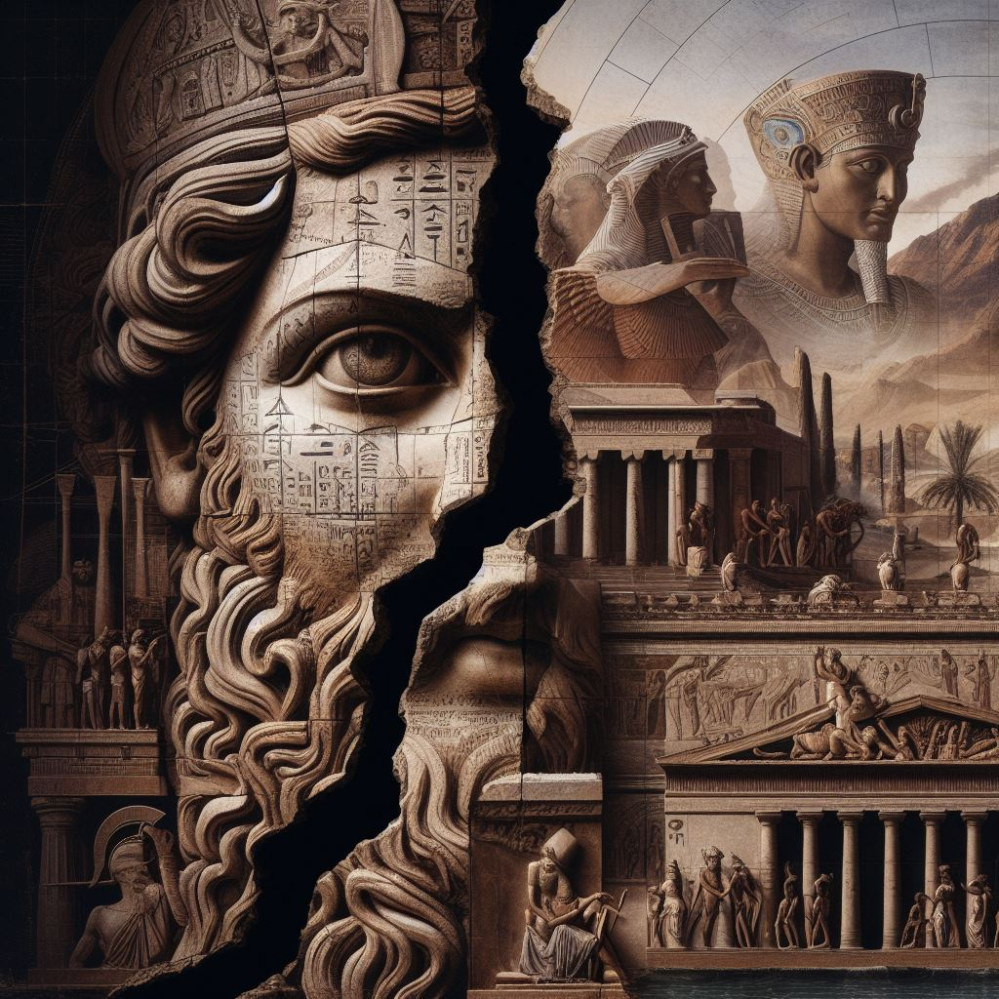
Introduction to Ancient History
GOAL/S: Identify and describe the geographical features of Ancient Rome
Week 1, Lesson 1

Slide 2

Classroom Expectations
Show respect to me, each other, and the classroom
Be on time for class
Come prepared for class
Ask for help when you need it
Watch your language

Slide 3
Work Expectations
Complete all tasks to the best of your ability
Catch up on missed work
Be organised – if you are not ahead you will fall behind
Have a go at everything
Use Compass and your textbooks
Create study resources
Attend HISTORY Study – optional but HIGHLY RECOMMENDED
Notes:
NOTES: Permission Slips – viewing and study club

Slide 4
Course Overview
Resources and units
If you have any questions – please ask!

Slide 5
Unit 3 – Societies and Change
Term/Week | Topic/Content | Assessments
T1 - 1 | Roman Society Overview
T1 - 2 - 3 | Roman Soc/Pol/Eco/Religion/Cul
T1 – 4 - 6 | Tiberius and Gaius Gracchus (133 – 121 BCE) | Essay (Week 6 – 10%)
T1 – 7 - 9 | Gaius Marius (133 – 87 BCE) | Source Analysis (Week 9 – 10%)
T2 – 1 - 3 | Sulla (90 – 78 BCE)
T2 – 4 – 5 | EST | EST (Week 4 – 5 – 15%)
T2 – 5 - 6 | Pompey to 66 BCE | Historical Inquiry (Week 5 – 6 – 10%)
T2 - 7 | EXAMS

Slide 6
Unit 3 – Societies and Change
Rome, the Late Republic to the Lex Manilia c. 133 – 66 BCE
This Week:
Rome – Historical Context/Geography
Key People/Power
Political Structures

Slide 7
The Late Roman Republic (133–66 BCE) was a tumultuous period marked by political upheavals, military expansion, and social unrest. This era saw the decline of the Roman Republic and the rise of influential figures like Pompey, Caesar, and Crassus, signaling a shift from senatorial authority to the dominance of military leaders. The Lex Manilia of 66 BCE granted Pompey extraordinary powers in the war against Mithridates VI of Pontus. Internally, Rome faced social and economic challenges, including land distribution issues and tensions between the patrician and plebeian classes, leading to civil conflicts. Externally, Rome's territorial expansion peaked with conquests in the Mediterranean and Asia Minor, but the vast empire posed administrative challenges, contributing to governance strains. The Late Republic was a pivotal time, marked by political intrigues, military influence, and societal changes, setting the stage for the Republic's demise and the emergence of the Roman Empire.

Slide 8
Review – Romulus and Remus
https://www.youtube.com/watch?v=erIKsNgVeh8&ab_channel=SeeUinHistory%2FMythology

Slide 9
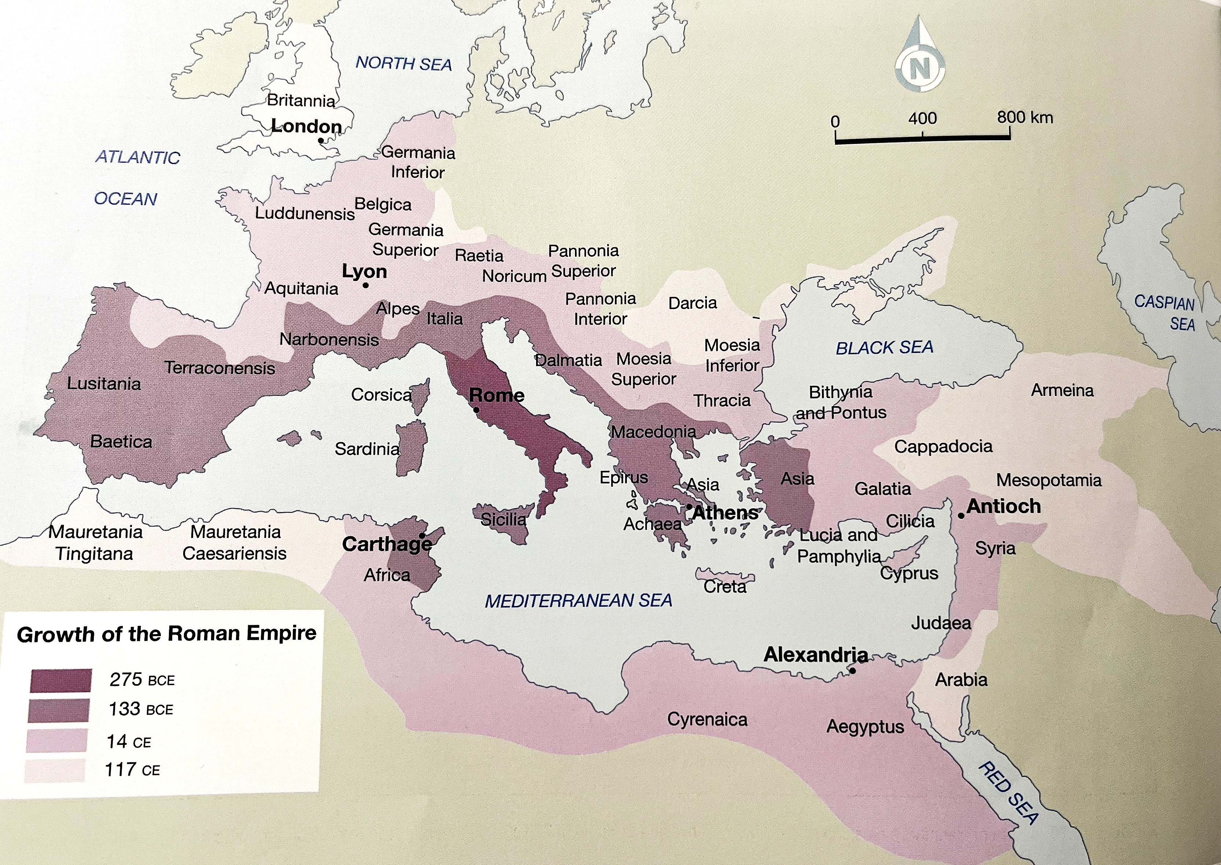
Notes:
Source – Italy is in the middle of the Mediterranean Sea. This meant that it could conquer territory all across Europe and North Africa, and then manage power from its centre of power – the city of Rome.

Slide 10
Geography of Rome
RIVER AND SEA
Tiber River – trading route, access to the Mediterranean Sea (travel/trade/conquer)
Mediterranean called Mare Nostrum or ‘Our Sea’
MOUNTAIN AND HILLS
mountainous – protected by Apennine Ranges
famously built on 7 hills for defense
FARMING
good farming land at base of hills
volcanic activity – nutrient-rich soil

Slide 11
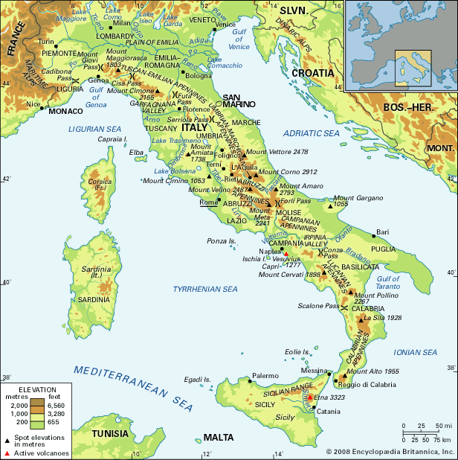
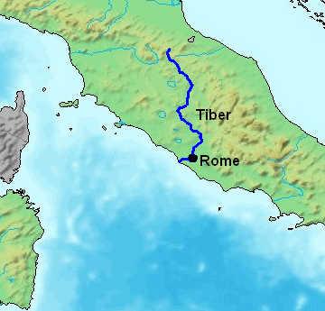

Slide 12
ACTIVITY – Source Analysis
SOURCE A
“With good reason did the gods and men choose this site for the founding of the city. Rome’s hills provide a healthy environment, the Tiber is favourable for navigation upstream to inland crops and downstream to the sea, and the sea itself is close enough for trade and yet far enough that we are not in danger of invasion by foreign fleets. Consider too Rome’s location at the centre of Italy. This site is uniquely suited by nature for the expansion of a city – as is proved by the size itself of our city while yet so young.”
Livy, History 5.54.5 from Peter J Aicher, Rome Alive: A Source Guide to the Ancient City, Vol. 1, 2004.
DISCUSSION QUESTIONS:
Which one (1) of the following in (a) and (b) to best describe Source 1. (3 marks)
ancient source ☐
modern source ☐
AND
written source ☐
archaeological source ☐
map/diagram ☐
reconstruction ☐
Outline why you selected the type/s of source listed above:
Outline FOUR (4) pieces of information that are provided by Source 1. (4 marks)

Slide 13
ACTIVITY – Source Analysis
SOURCE B
“It is a fact that southern nations, although extremely clever, give way when it comes to a contest of courage. This is because their spirit has been [weakened] by the hot sun Conversely, people born in the [cold] regions of the north, though better suited for the violence of warfare on account of their fearless courage, are slow of mind, and [have] no thought of strategy.
... the peoples of Italy are tempermentally balanced in each direction, having both physical strength and mental vigour suited to their courage… Thus did divine intelligence situate the city of the Roman people in an extraordinary and temperate region, so that it might extend its empire across the world.”
Vitruvius, Architecture 6.1 10 – 11, from Peter J Aicher, Rome Alive: A Source Guide to the Ancient City, Vol. 1, 2004.
DISCUSSION QUESTIONS:
Which one (1) of the following in (a) and (b) to best describe Source 1. (3 marks)
ancient source ☐
modern source ☐
AND
written source ☐
archaeological source ☐
map/diagram ☐
reconstruction ☐
Outline why you selected the type/s of source listed above:
Outline FOUR (4) pieces of information that are provided by Source 1. (4 marks)

Slide 14
SUMMARY
What is the most important geographical advantage
rome had?
IDENTIFY and give two (2) reasons to support your answer.

